Slide 1
CS7GV1 Project
Monocular Object Detection
and Distance Estimation
Steven Bondaruk & Joseph Hand

Slide 2
Background
The aim of this project is to create a monocular distance estimation system using detected objects as reference points for size.
Identify key objects like licence plates, people and bicycles. These can be used to distance from the camera.
Following image functionality, move onto video processing, requiring an efficient model.

Slide 3
Aims of Literature Review
See current approaches to the issue.
Find any potential research gaps that we can work to address, particularly with video work.
Any particularly successful approaches, along with any machine learning models that might have been used during the research process.
Prioritising recent literature, with methods aiming for efficiency such that video is more reasonable to consider during the project.

Slide 4
Approach
Use Object Detection models to identify priority objects within the scene (people, vehicles, license plates).
License Plate Detection Model: Detection model specifically trained to find license plates within an image. With this model, we gain more information
YOLO Object Detection Model: Versatile and efficient object detection model capable of identifying a wide range of object classes.
Apply computer vision techniques to determine approximate distance between the camera and the objects.
Approximate the distance between the 2 objects once the distance between the objects and camera is known

Slide 5
Object Detection
Use the pre-trained YOLOv8 model to perform object detection.
We have defined classes to include only person and bicycle.
A pre-trained license plate detector model is used to detect license plate on the vehicles.
Once the cyclist and license plate is detected we can then approximate their location.

Slide 6
Distance Estimation
Once we have detected the necessary objects, we can proceed in approximating the distance between the camera and the detected objects.
To determine the distance we can utilize triangle similarity. We need known object width, perceived object width, and focal length.
To calculate focal length we use this formula:
F = (P x D) / W
P = pixel width, D = known distance, W = known object width
Once we have the focal length we can now calculate distance with this rearranged formula:
D = (W x F) / P

Slide 7

Distance Estimation
Once the distance from camera to object is determined, we can now estimate the distance between the cyclist and vehicle.
To determine the distance between 2 objects more accurately, we take the FOV angle of the footage into account.
We can use the cosine rule to calculate the distance between 2 objects.
Cosine Rule:

Slide 8
Code Demonstration for Object Detection and Distance Estimation

Slide 9
Use of Depth Estimation Models
Another consideration could be to take a depth estimation model to derive relative distance between objects in a scene.
We tested this idea with the Depth Anything V2 model, which highlighted its accuracy and efficiency in comparison to other models. Several models can be used, ranging from 25 Million to 1.3 Billion parameters, depending on the necessity.
We chose the smaller model to ensure minimal impact on performance.

Slide 10
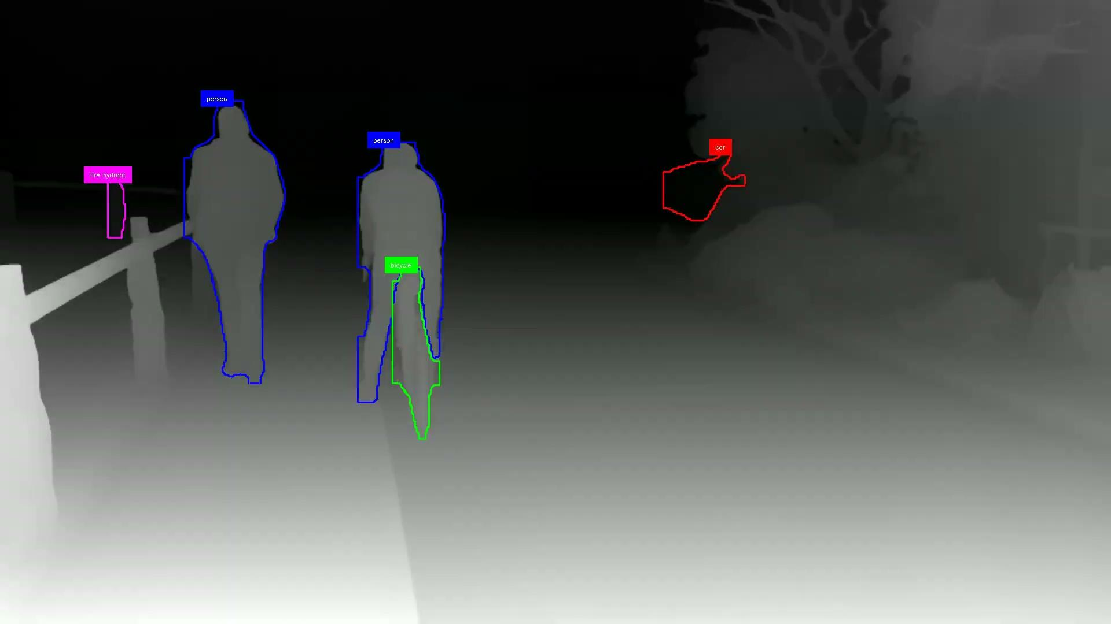
Future Work
Once a metric can be extracted from the image, a depth estimation model could be used to glean more depth information.
Pixel values of key objects can be extracted and compared to other detected objects in the scene.
A segmentation detection model can be used to only consider the relevant pixels of an object.
Another potential approach could come from extensions of depth estimation models that also estimate absolute depth.
Depending on efficiency of methods, testing on live video could be done.

Slide 11
Credits
Chang, J. and Wetzstein, G. (2019). Deep Optics for Monocular Depth Estimation and 3D Object Detection. [online] openaccess.thecvf.com. Available at: https://openaccess.thecvf.com/content_ICCV_2019/html/Chang_Deep_Optics_for_Monocular_Depth_Estimation_and_3D_Object_Detection_ICCV_2019_paper.html.
Armin MASOUMIAN, David G. F. MAREI, Saddam ABDULWAHAB, Julián CRISTIANO, Domenec PUIG and Hatem A. RASHWAN (2021). Absolute Distance Prediction Based on Deep Learning Object Detection and Monocular Depth Estimation Models. Available at: https://ebooks.iospress.nl/doi/10.3233/FAIA210151
Find distance from camera to object/marker using Python and OpenCV: https://pyimagesearch.com/2015/01/19/find-distance-camera-objectmarker-using-python-opencv/
YOLOv8 Object Detection model: https://docs.ultralytics.com/
License plate detector model: https://github.com/Muhammad-Zeerak-Khan/Automatic-License-Plate-Recognition-using-YOLOv8?tab=readme-ov-file

